Slide 1
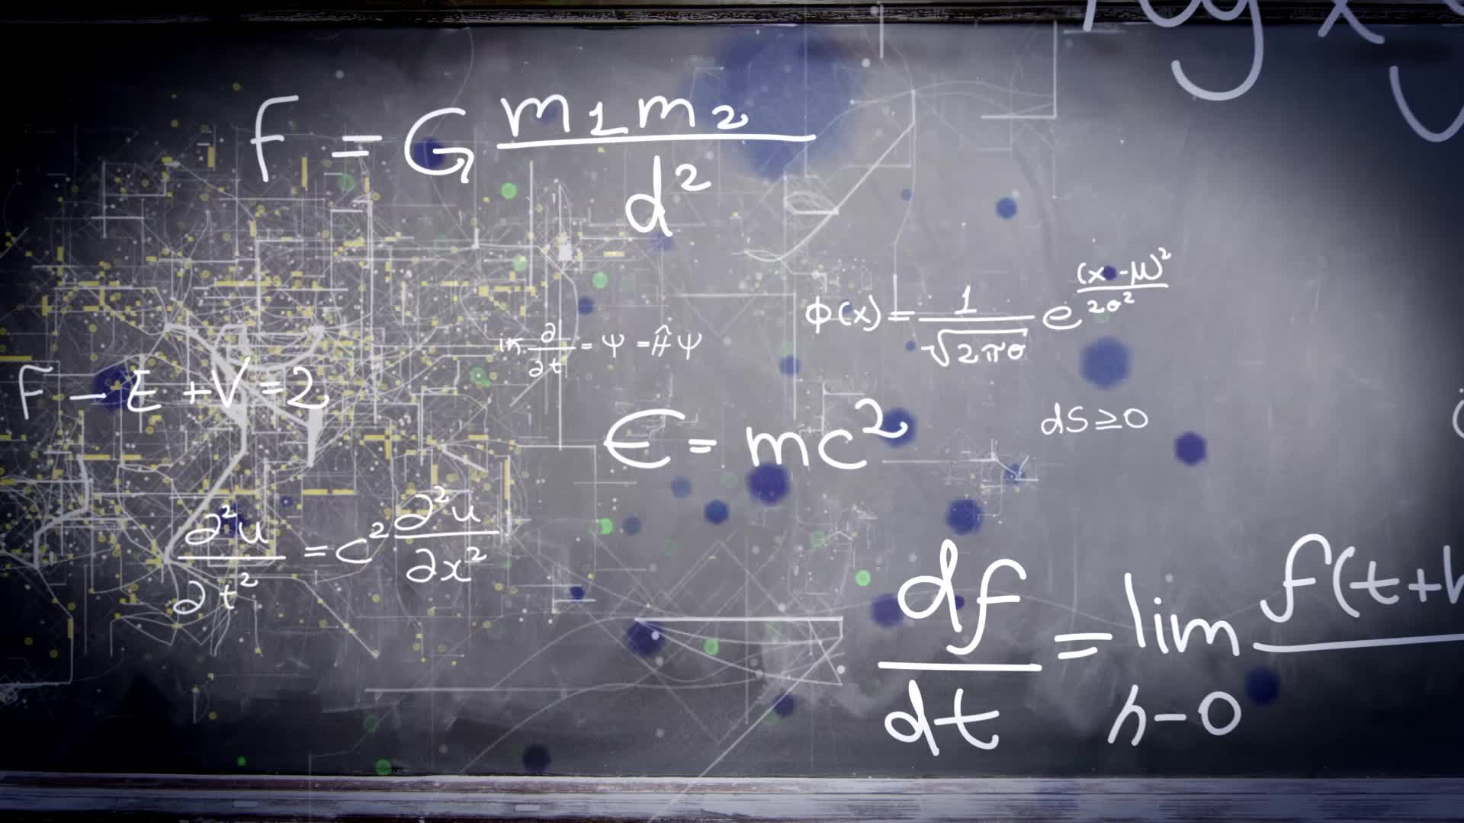
Chapter 1.4:
Continuity and One-Sided Limits
HONORS CALCULUS/CALCULUS

Slide 2
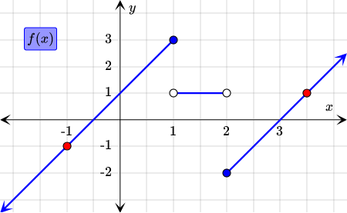
One-Sided Limits
$$\lim_{x→c^{−}}{f\left(x\right)=L}$$
Limit of $f(x)$is equal to $L$ as $x$ approaches $c$ from the left
$$\lim_{x→c^{+}}{f\left(x\right)=L}$$
Limit of $f(x)$is equal to $L$ as $x$ approaches $c$ from the right

Slide 3
Existence of a Limit
Let $f$ be a function and let $c$ and $L$ be real numbers. The limit of $f(x)$ as $x$ approaches $c$ is $L$ if and only if
$$\lim_{x→c^{−}}{f\left(x\right)=L}$$
and
$$\lim_{x→c^{+}}{f\left(x\right)=L}$$

Slide 4
Continuity: A function $f$ is $continuous at c$if the following conditions are met:
$f\left(c\right)is defined$
$\lim_{x→c}{f\left(x\right)}exists$
$\lim_{x→c}{f\left(x\right)}=f(c)$

Slide 5
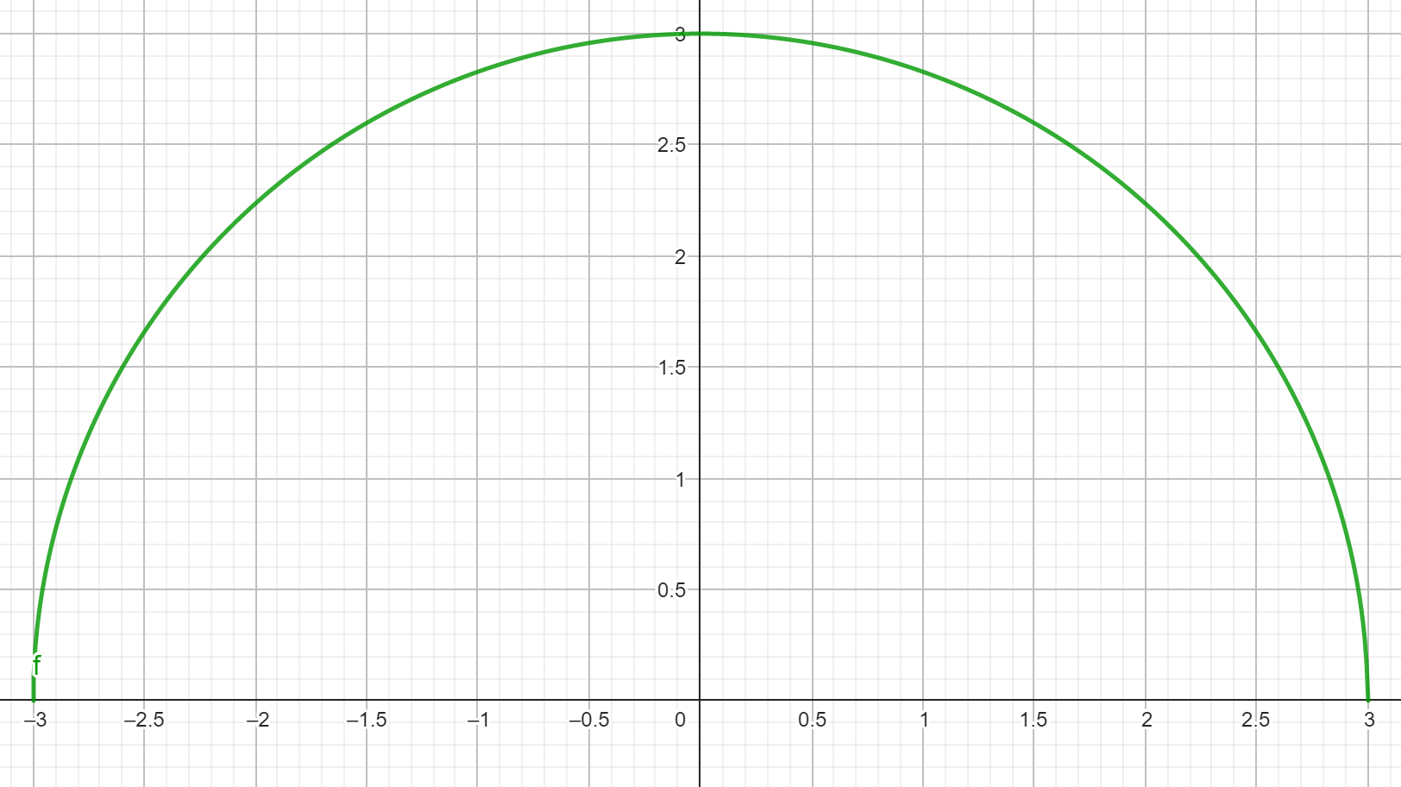
Continuity on a Closed Interval: A function $f$ is continuous on the closed interval $[a, b]$if it is continuous on the open interval $(a, b)$and
$$\lim_{x→a^{+}}{f\left(x\right)=f\left(a\right) and \lim_{x→b^{−}}{f\left(x\right)=f(b)}}$$
the function $f$ is continuous from the right at $a$ and continuous from the left at $b$.

Slide 6
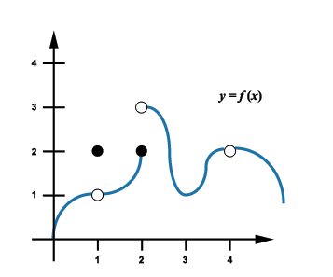
Ex. 1)
$$Is f\left(x\right) continuous at x=2?$$

Slide 7
Ex. 2)
$$Is f\left(x\right) continuous at x=1?$$

Slide 8
Ex. 3)
$$Is f\left(x\right) continuous at x=3?$$

Slide 9
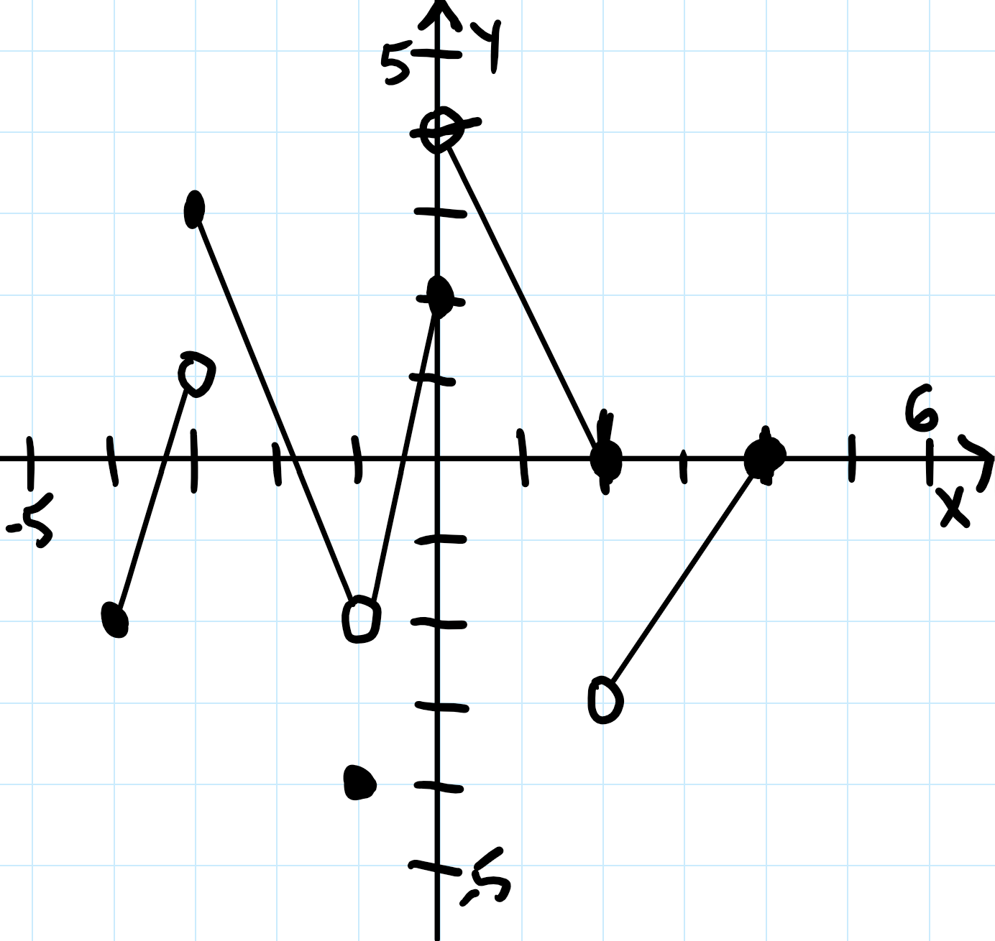
Ex. 4)
$$Is f\left(x\right) continuous at x=−2?$$
$$Is f\left(x\right) continuous at x=−1?$$
$$Is f\left(x\right) continuous at x=0?$$

Slide 10
Ex. 5)
$$f\left(x\right)=\left\{\begin{aligned}2x+3, x≤4 \\ 7+\frac{16}{x}, x>4\end{aligned}\right.$$
$$Is f\left(x\right) continuous at x=4?$$

Slide 11
Ex. 5)
$$f\left(x\right)=\left\{\begin{aligned}x+1, x≤4 \\ x^{2}+1, x>4\end{aligned}\right.$$
$$Is f\left(x\right) continuous at x=4?$$
$$Is f\left(x\right) continuous at x=0?$$

Slide 12
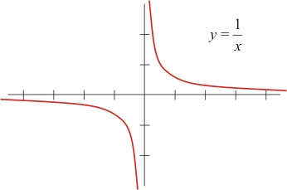
Ex. 6)
$$Discuss the continuity of f\left(x\right)=\frac{1}{x}.$$
$$f\left(x\right)=\frac{1}{x}$$

Slide 13
Types of Discontinuities
Removable Discontinuity
A discontinuity at $c$ is removable if $f$ can be made continuous by appropriately defining or redefining $f(c)$
Point Discontinuity
Nonremovable Discontinuity
If the limit as $x$ approaches $f(x)$ does not exist, there is no way to fulfill the continuity test and the discontinuity is nonremovable.
Jump or Infinite

Slide 14
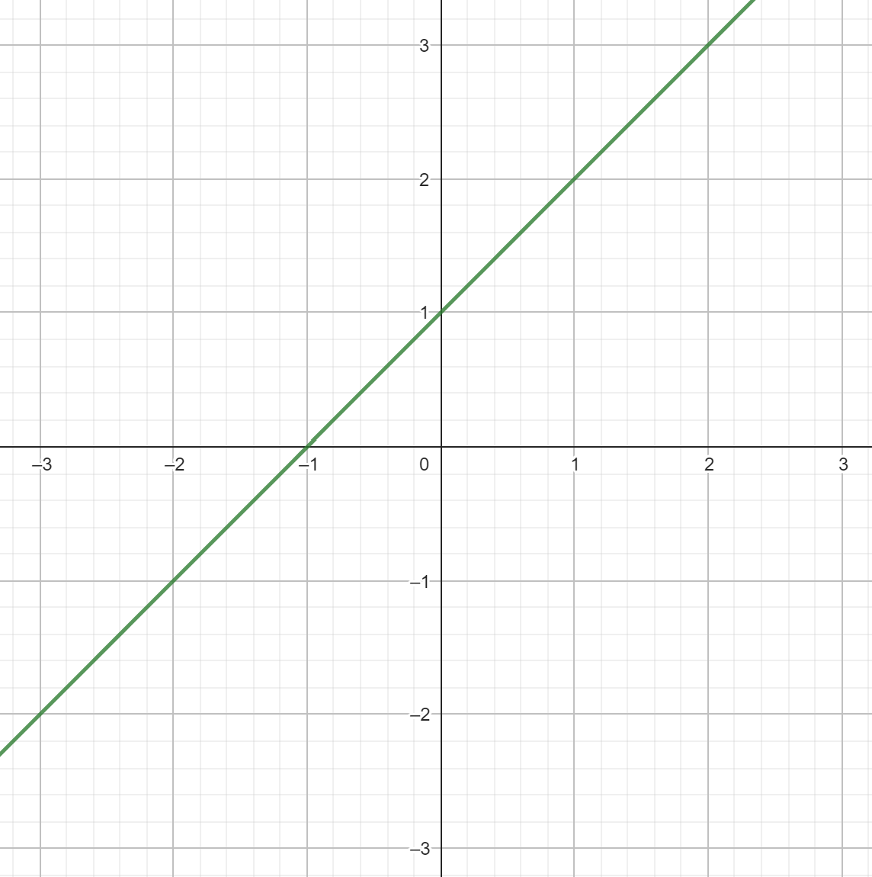
Ex. 7)
$$f\left(x\right)=\frac{x^{2}−1}{x−1}$$

Slide 15
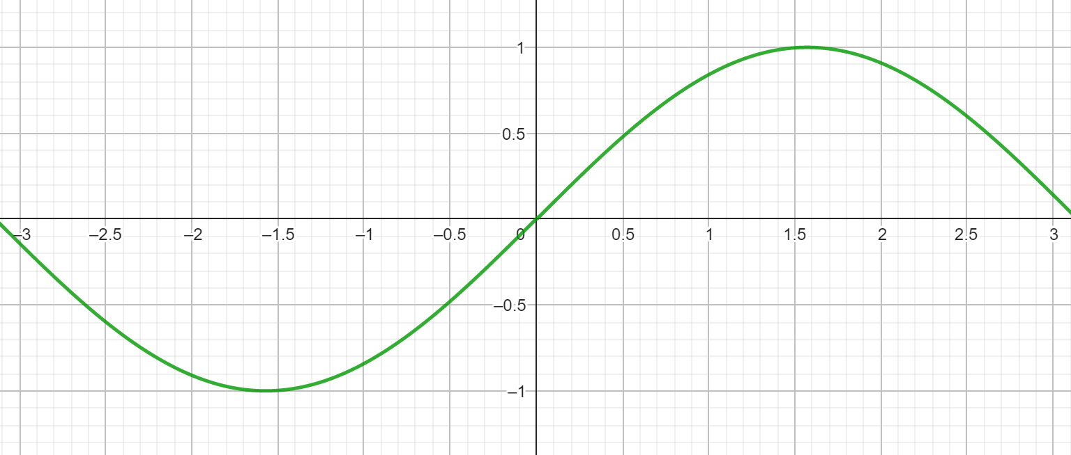
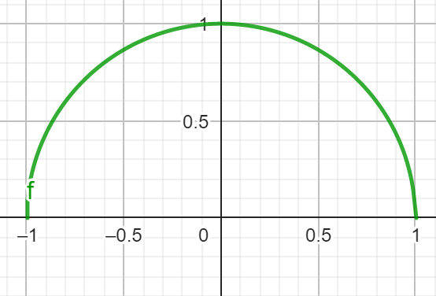
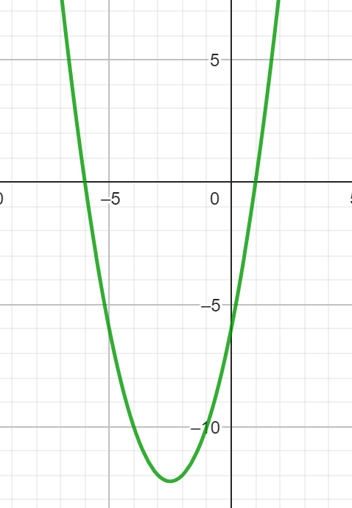
Ex. 8)
$$f\left(x\right)=sin(x)$$
$$f\left(x\right)=\sqrt{1−x^{2}},[−1, 1]$$
$$f\left(x\right)=x^{2}+5x−6$$

Slide 16
Ex. 9)
$$f\left(x\right)=\frac{x}{x^{2}−4}$$
$$f\left(x\right)=\frac{x−4}{x^{2}−16}$$

Slide 17
Ex. 10) Find the constant of a such that the function is continuous for all real numbers
$$f\left(x\right)=\left\{\begin{aligned}3x+a, x>4 \\ x^{2}, x≤4\end{aligned}\right.$$

